Slide 1

PROFESSIONAL CERTIFICATE IN MACHINE LEARNING AND ARTIFICIAL INTELLIGENCE
Week 8
Feature Engineering and Overfitting

Slide 2
Agenda
Non Linearity
Inference vs Prediction
Scikit-Learn Transformers (Data Preprocessing - Feature engineering)
Overfitting
Cross Validation
Parameters and Hyperparameters
Notes:
Inference
A statement about the relationship between the response and the predictor variables
Overfitting
A modeling error where a function is too closely fit to a limited set of data points resulting in an inability of the model to generalize to other datasets
Pipeline
A scikit-learn functionality that assembles several steps that can be cross-validated together while setting different parameters
Prediction
A conclusive statement that pertains to a future event or occurrence
Test Set
A subset of the initial dataset that is set aside to test the trained model
Training Set
The dataset you use to train an algorithm or machine learning model
Validation Set
A subset of the initial dataset that is used to give an estimate of model skill while tuning the model’s hyperparameters

Slide 3
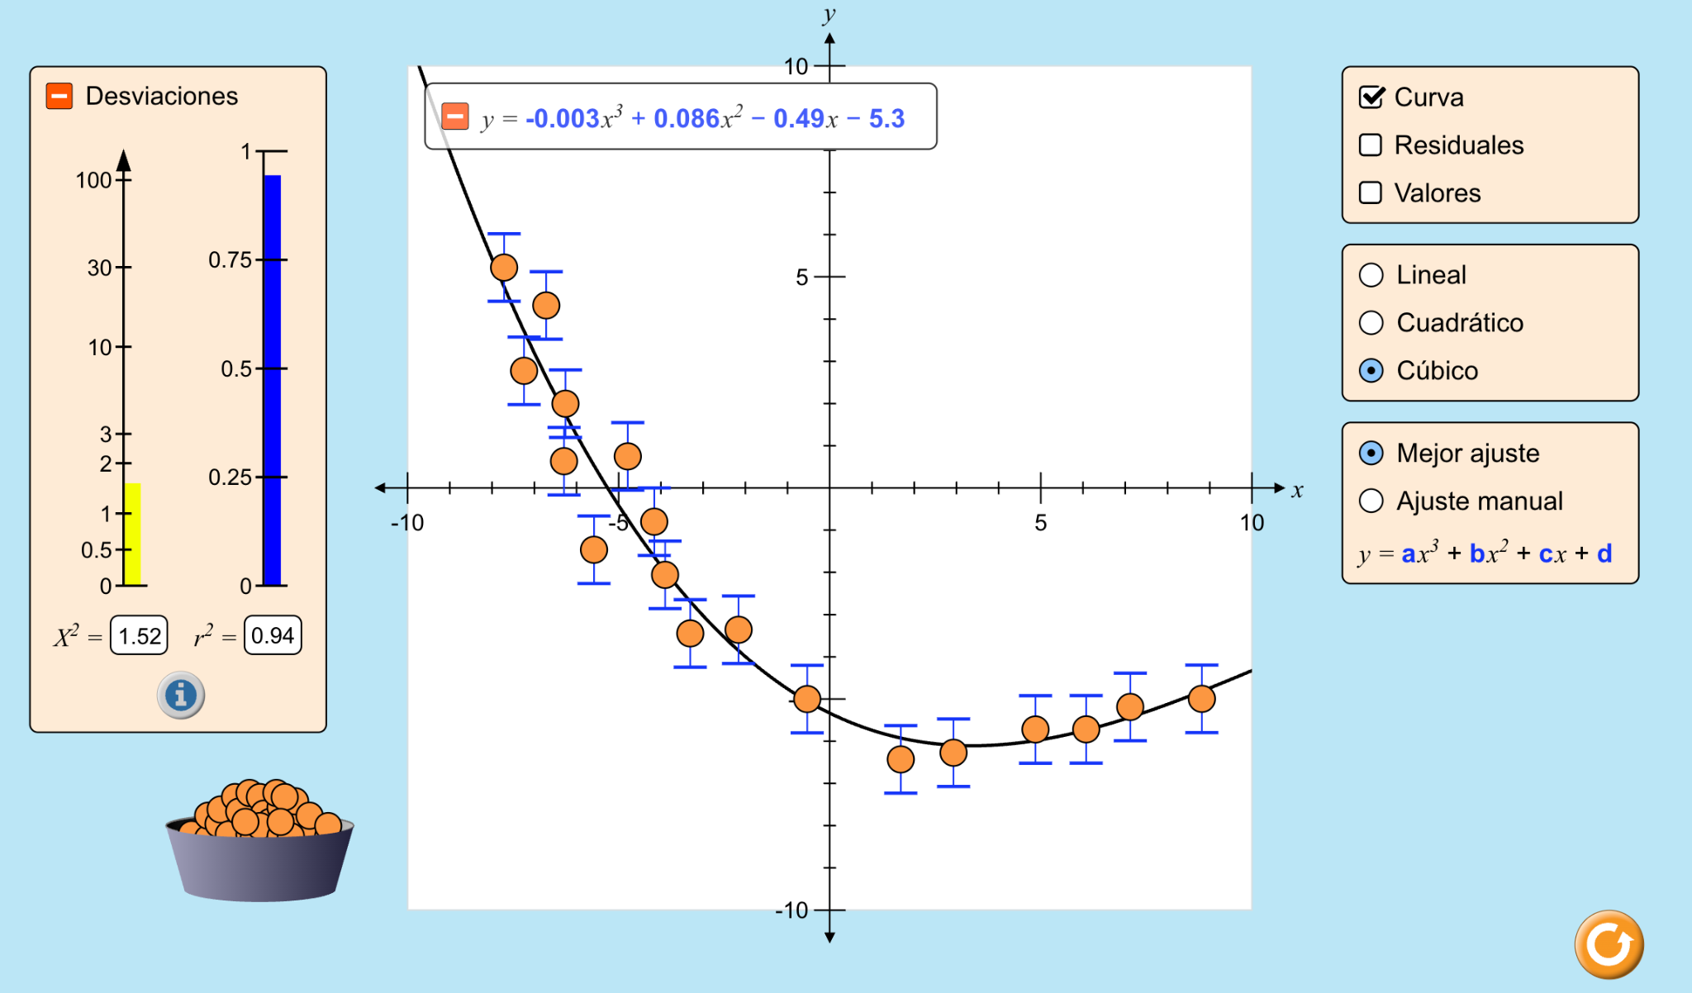
Non Linearity
Notes:
https://phet.colorado.edu/sims/html/curve-fitting/latest/curve-fitting_all.html?locale=es

Slide 4
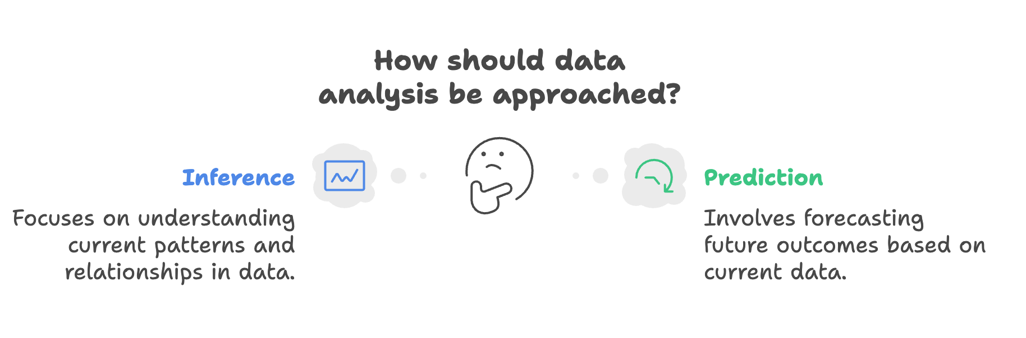
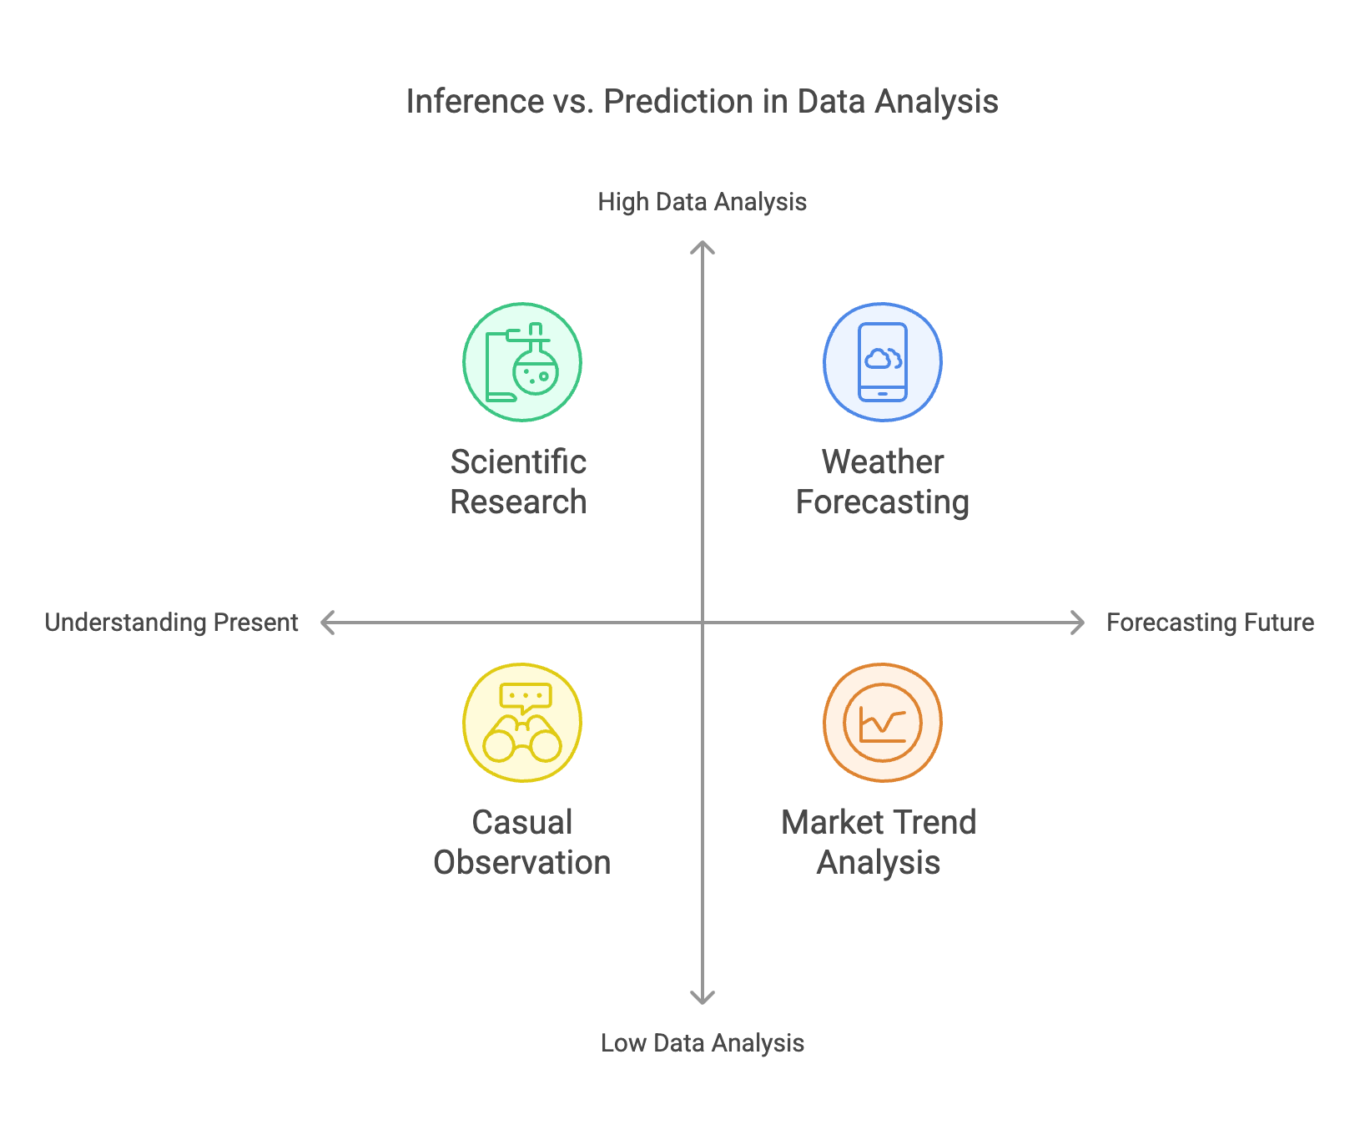
Inference vs prediction
Parameters for Comparison | Inference | Prediction
Definition | Inference describes a conclusion that is based on empirical evidence regarding data, facts, and evidence. | Prediction describes a conclusive statement that pertains to a future event or occurrence.
Answers the question | What do the relationships between the variables mean? | How can I accurately predict new data points?
Goal | Estimate an association between an outcome, variable, and a predictor variable. | Develop a ‘best’ model (where all predictors predict Y with high accuracy and low error).
Example | What has the biggest impact on fuel efficiency: horsepower or weight? | Given horsepower, what is a vehicle’s fuel efficiency?
Confidence of conclusion | Since inference is based on facts and evidence, you can have more confidence that the conclusion is correct. | Compared to inference, there is less certainty that a prediction will be correct because the future is unknown.

Slide 5
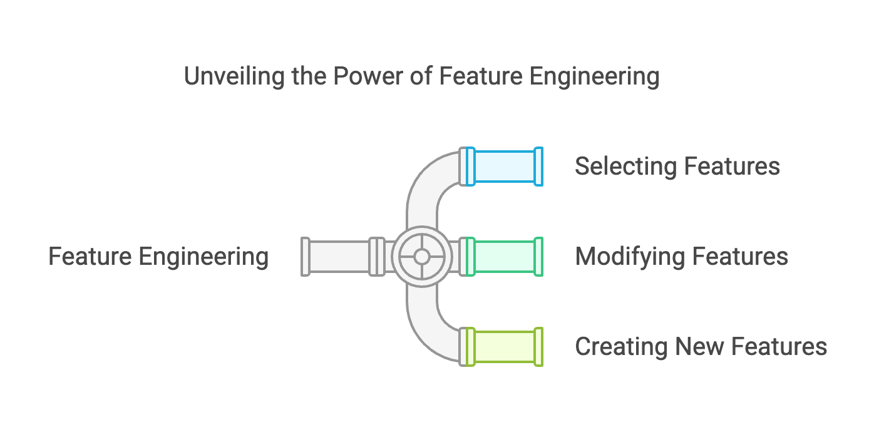
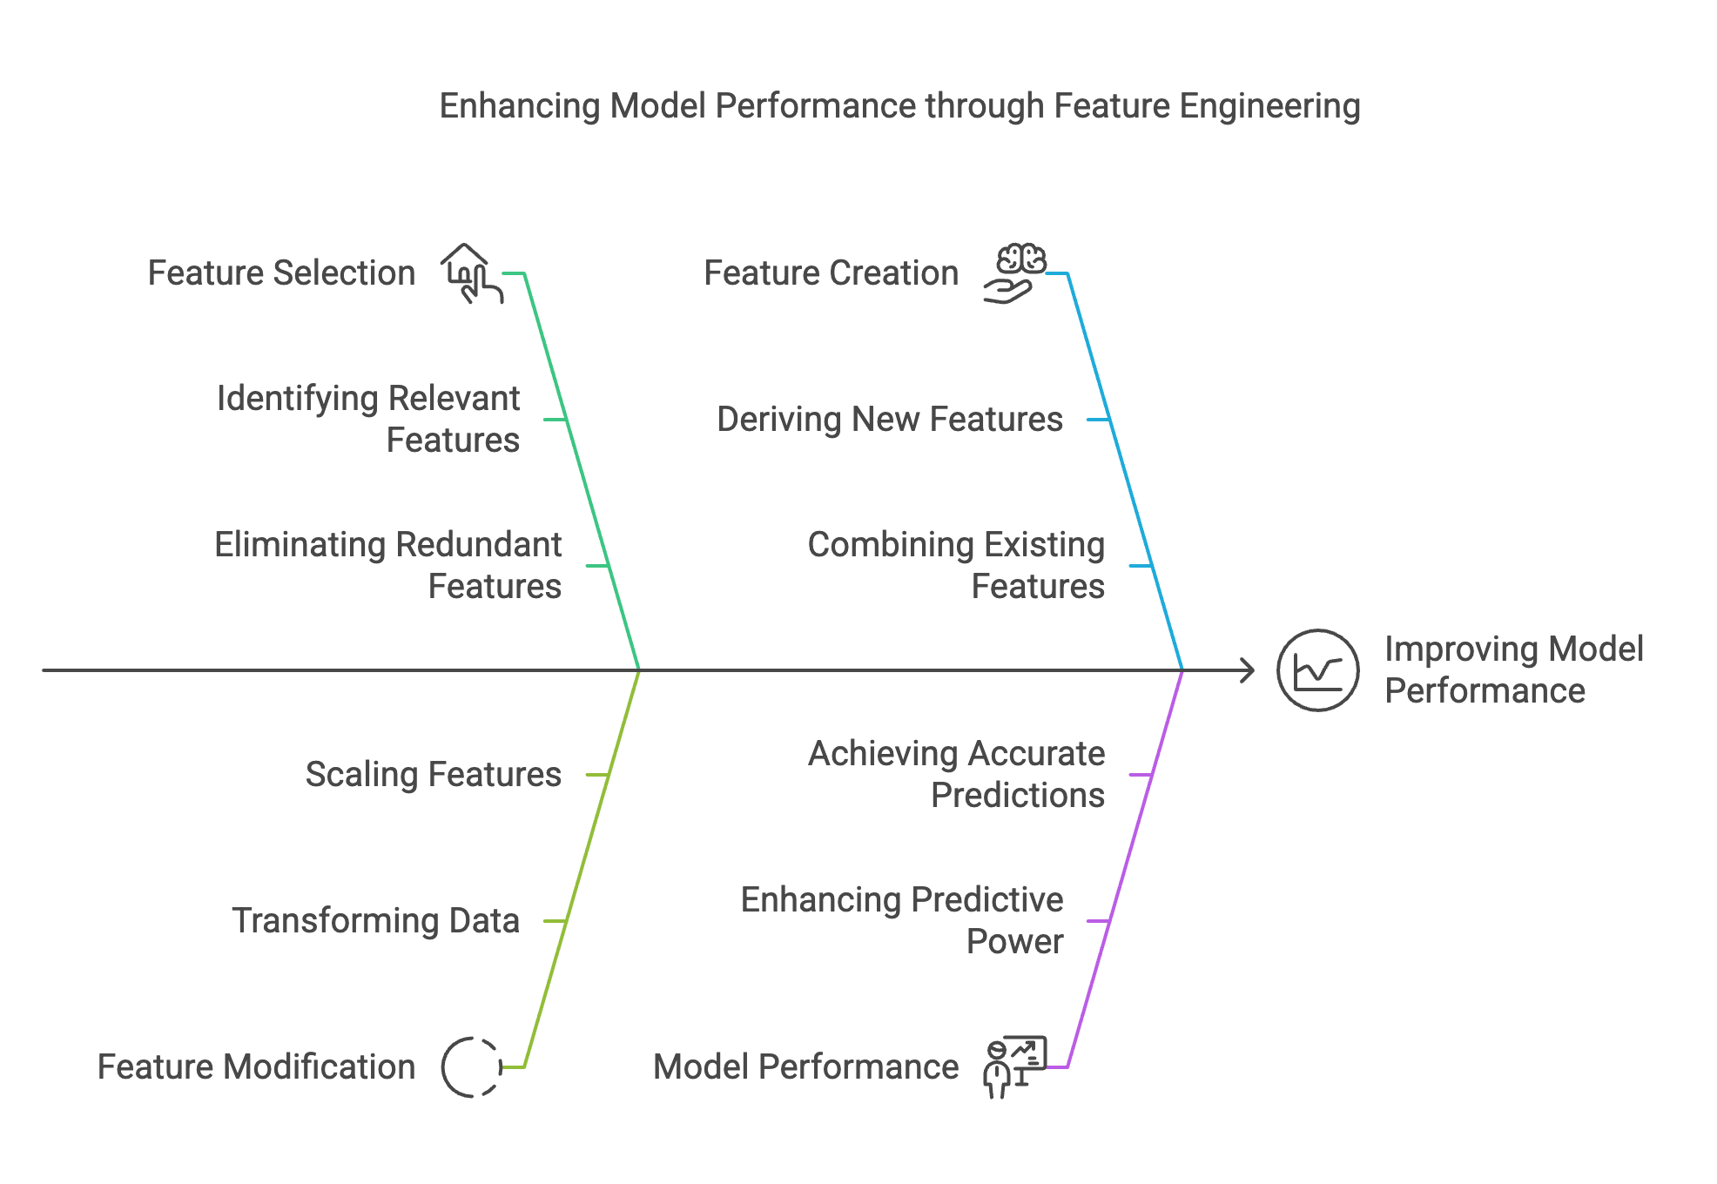
Feature Engineering

Slide 6
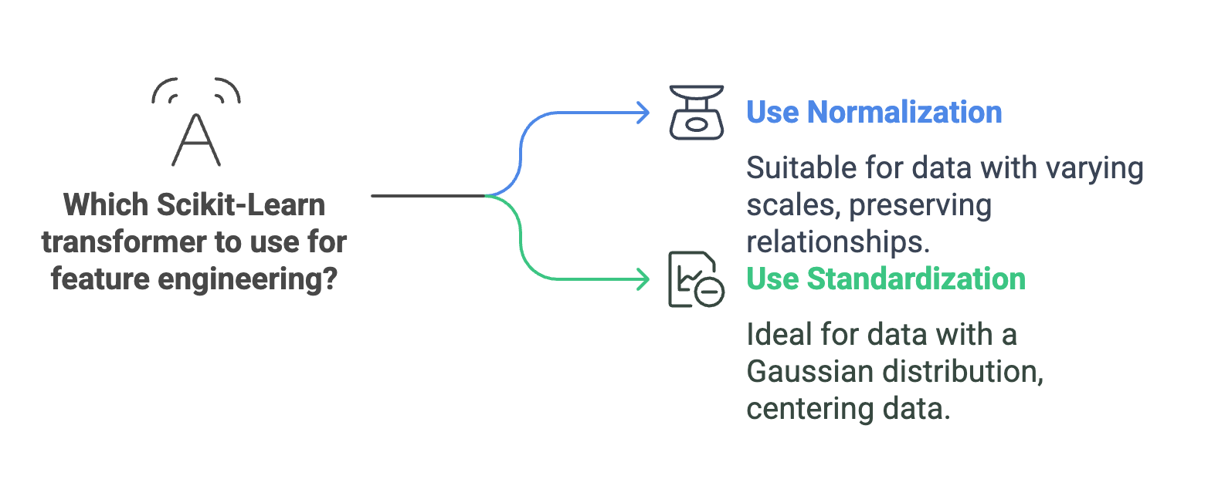
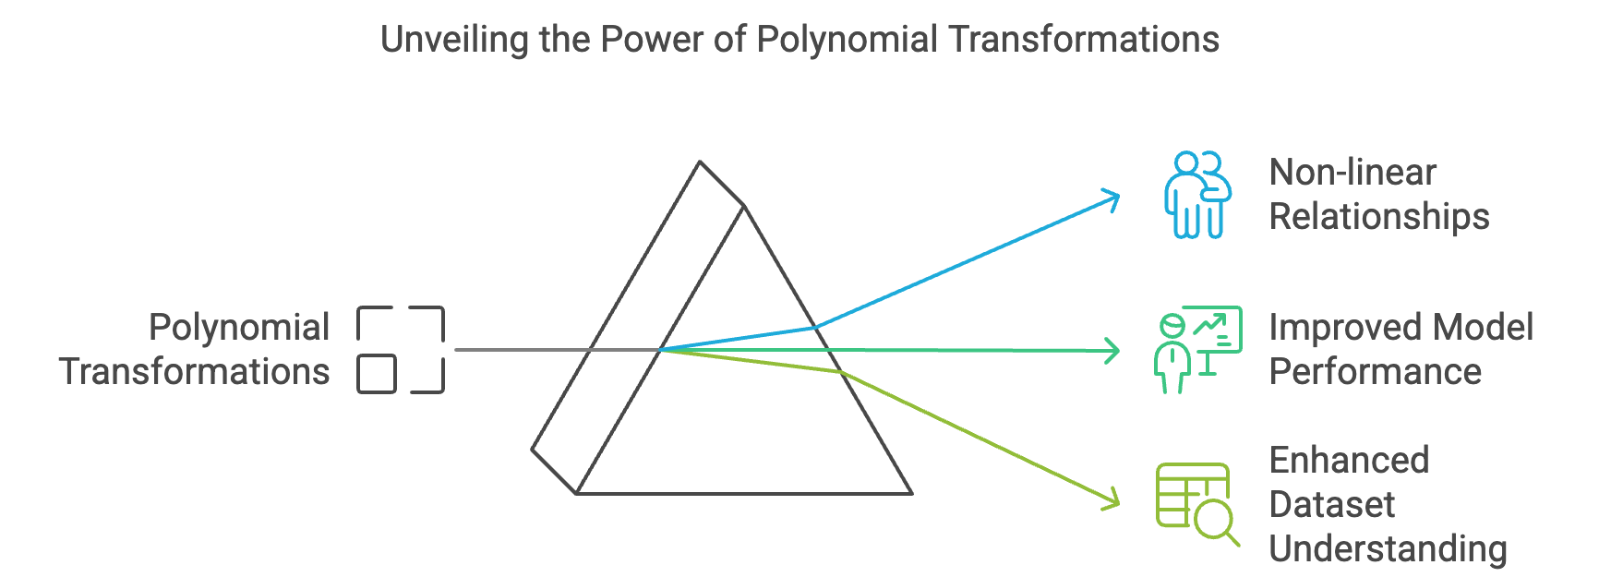
Scikit-Learn Transformers (Data Preprocessing - Feature engineering)

Slide 7
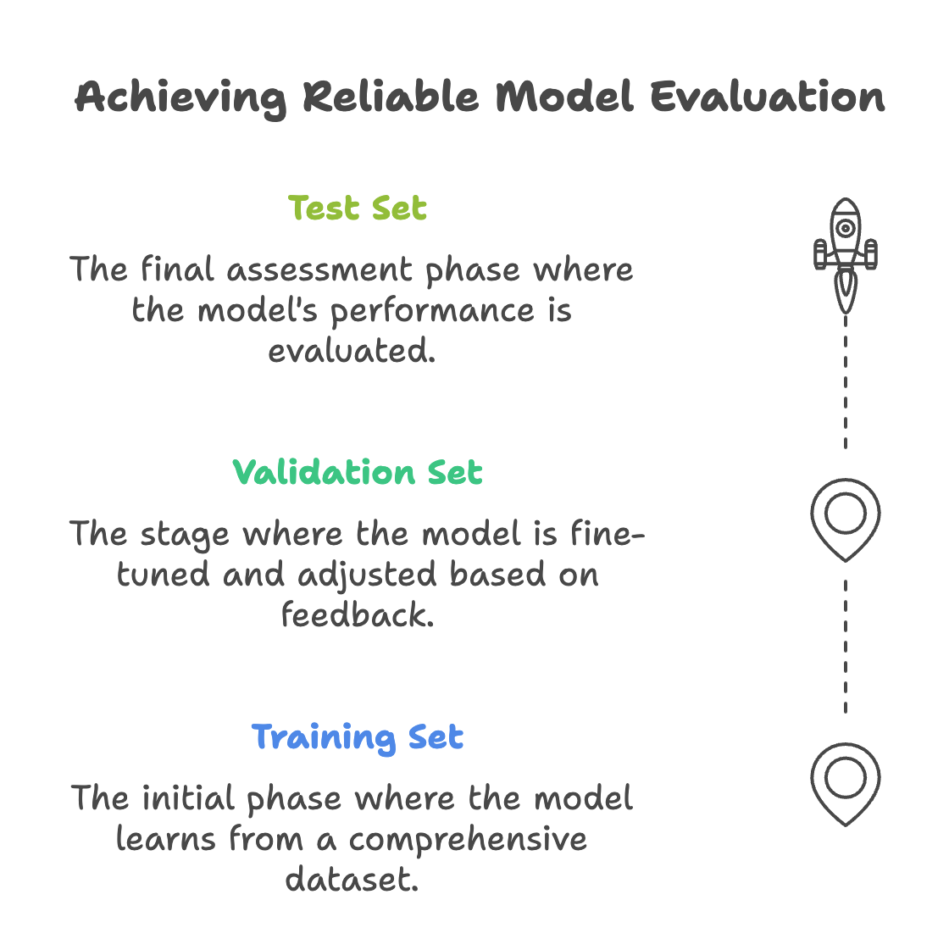
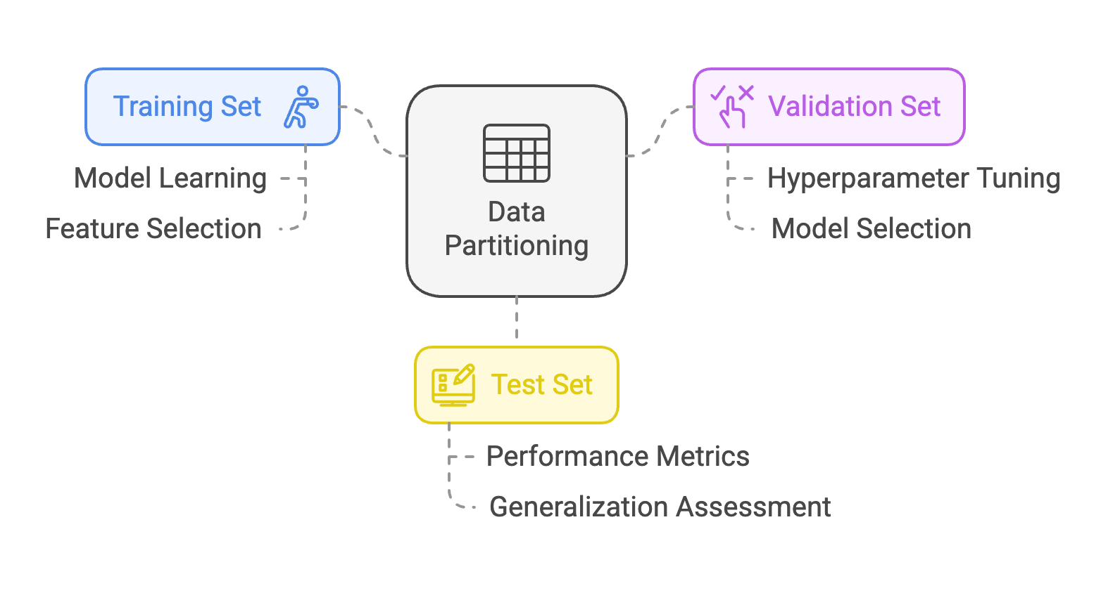
Dataset partitioning - Data Splitting

Slide 8
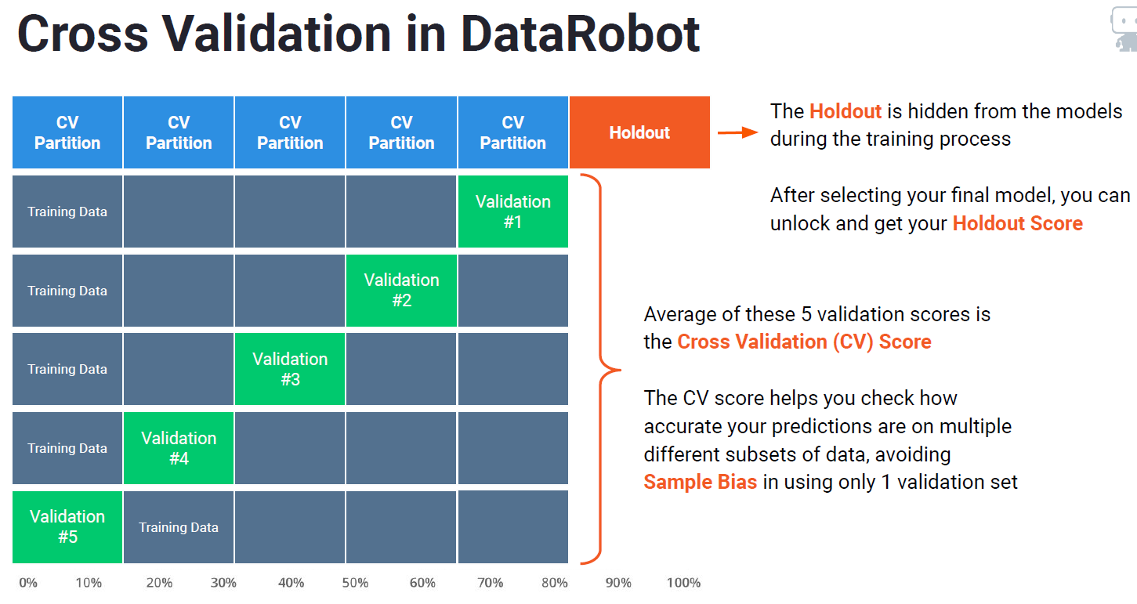
Hold Out
Test

Slide 9
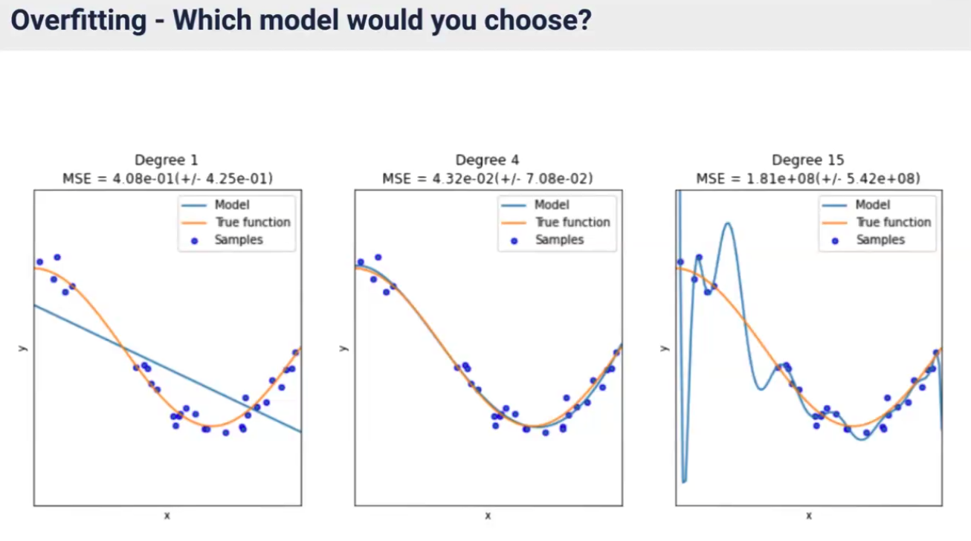

Slide 10
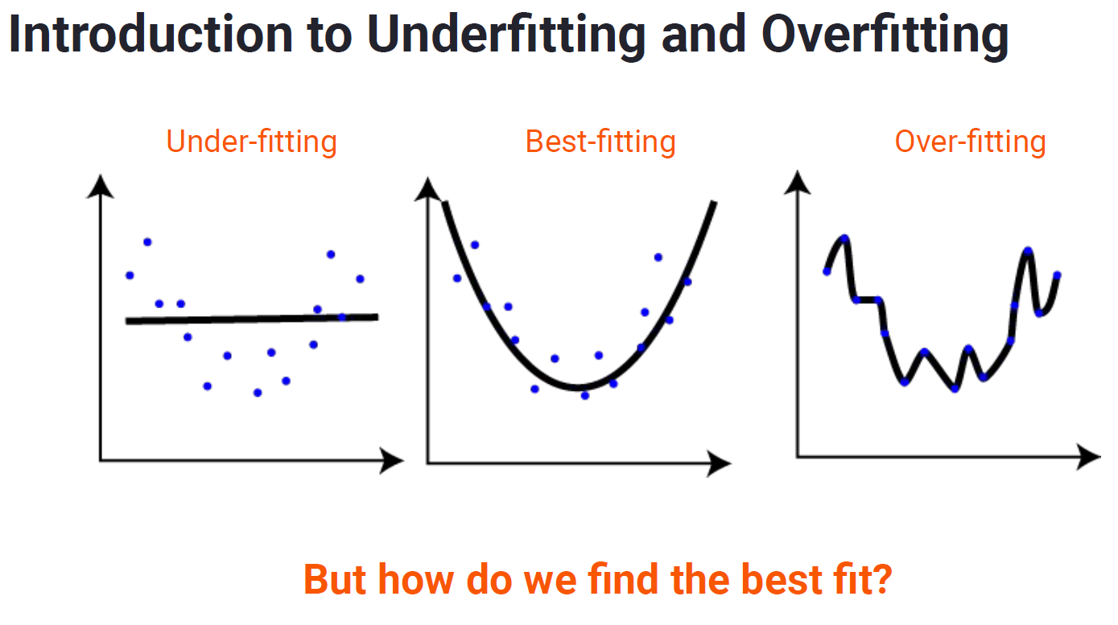
Validación del Modelo
Test

Slide 11
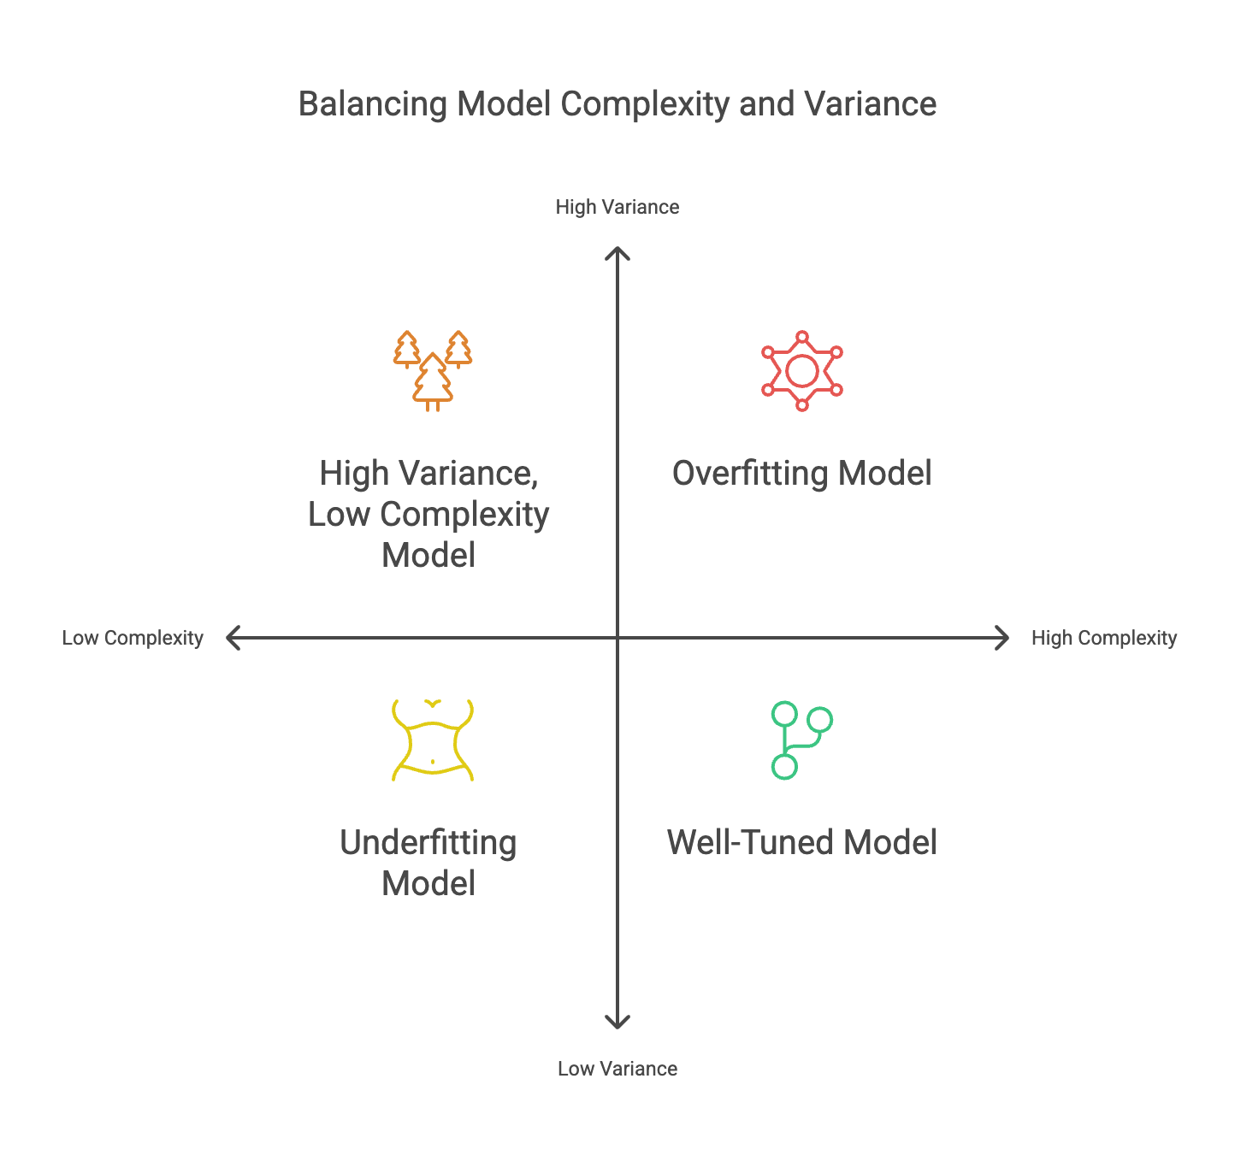
Model complexity vs variance

Slide 12
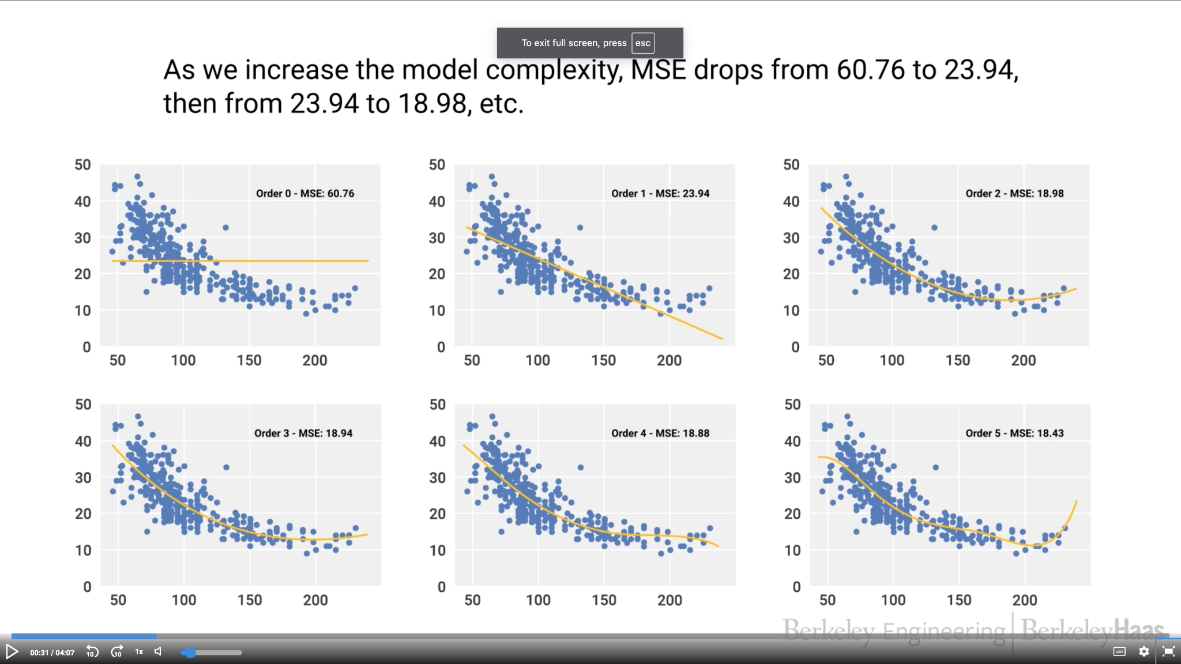
Model complexity vs variance

Slide 13
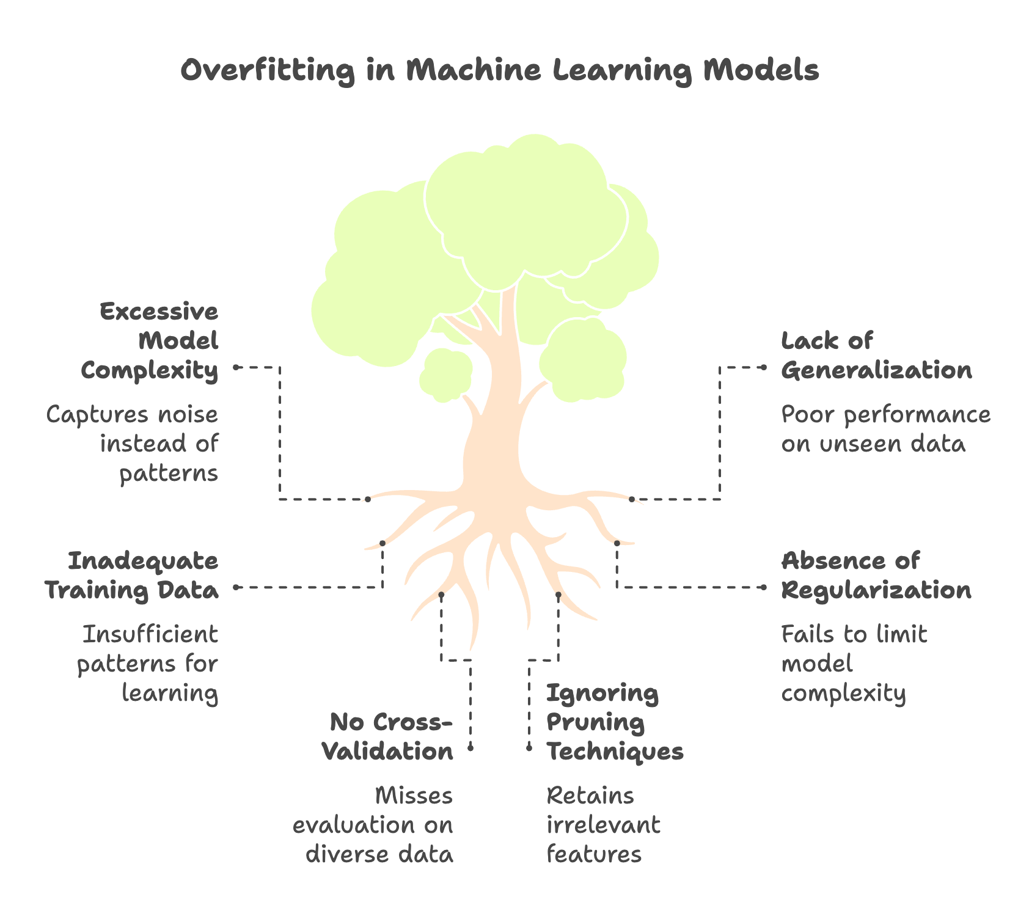
Overfitting

Slide 14
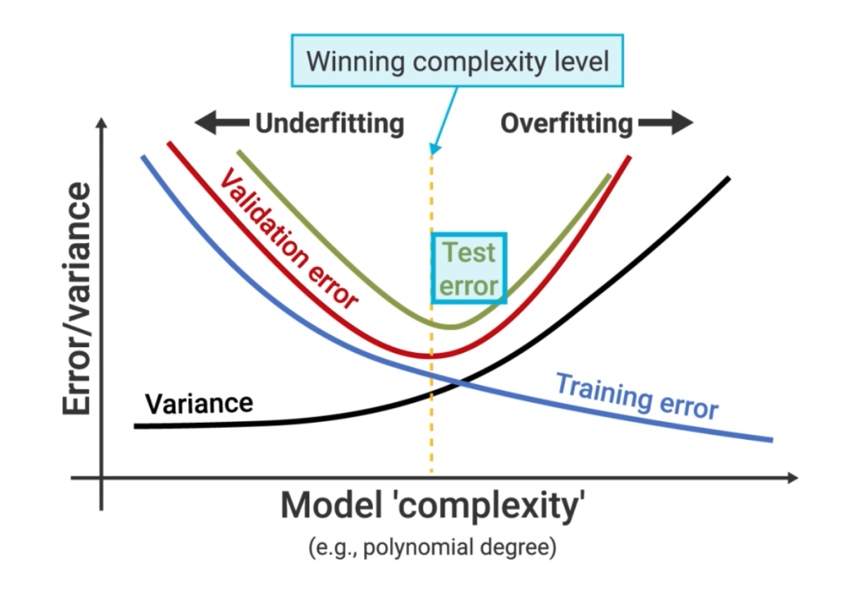
Overfitting

Slide 15
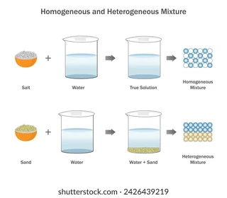
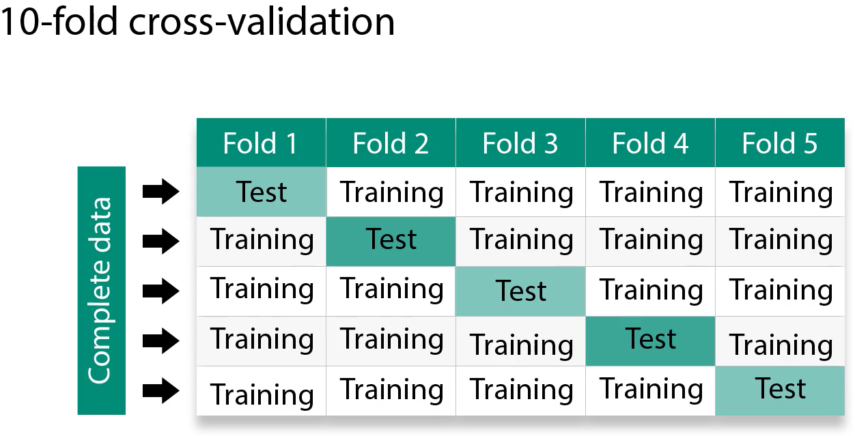
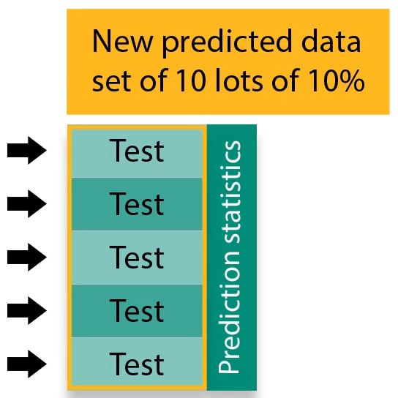
Homogeneidad y representatividad estadística
Test

Slide 16
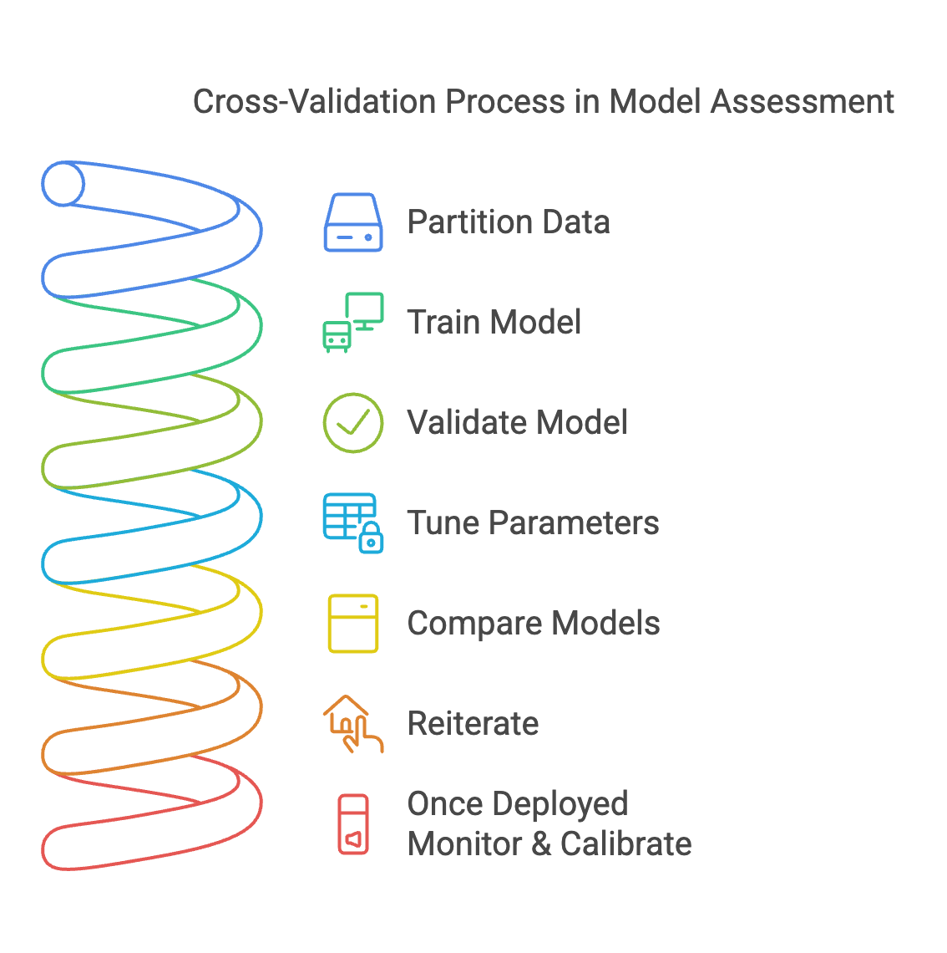
CV Process

Slide 17
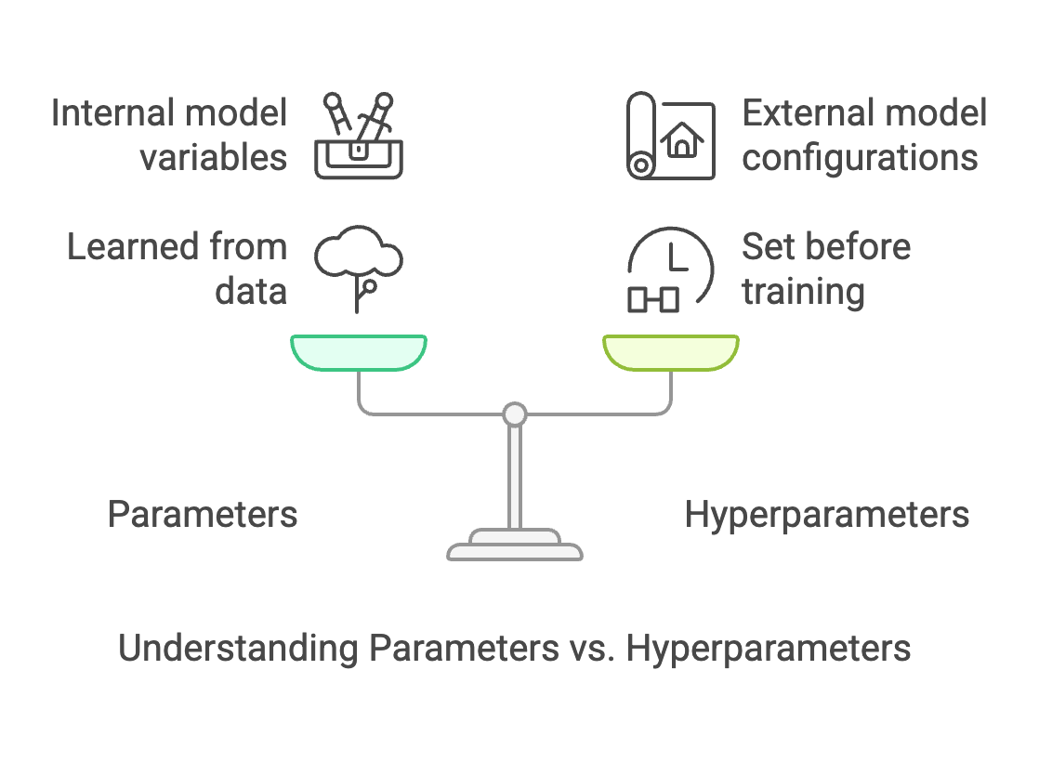
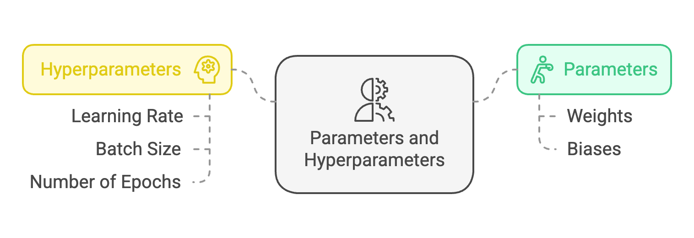
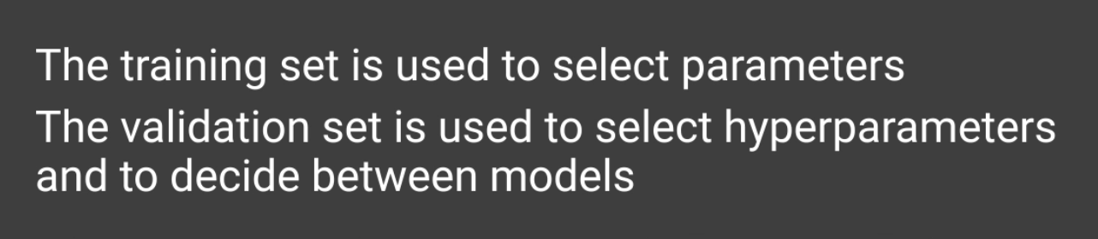
Parameters and Hyperparameters

Slide 18
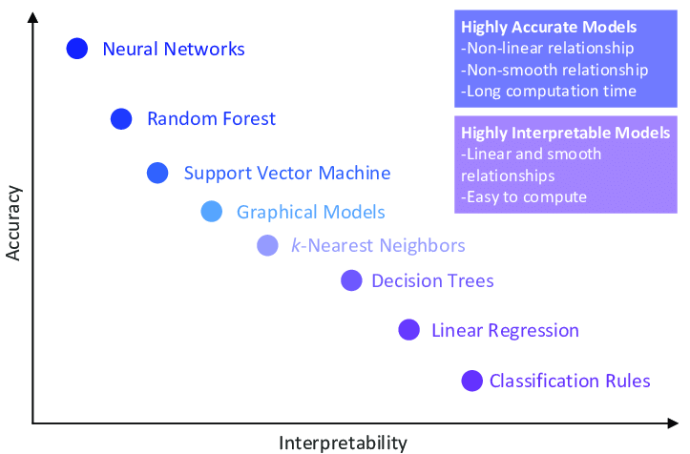
Model Complexity

Slide 19
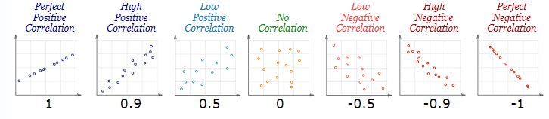
Correlation
Notes:
Correlation (rrr):
Describes the strength and direction of the relationship.
R-Squared (R2R^2R2):
Describes the proportion of variability explained by the model, without indicating direction.

Slide 20

ML Lifecycle
Obtain Data:
Acquire the dataset from various sources such as databases, APIs, files, repositories, web scraping , Open Data ,or any other 3rd party data in general like data Brokers that offer alternative data for data enrichment
Ensure data integrity and verify that the dataset is suitable for the intended machine learning task.
Explore Data:
Perform exploratory data analysis (EDA) to understand the structure, patterns, and characteristics of the dataset.
Summarize statistics, visualize data distributions, and identify potential issues such as missing values, outliers, or class imbalances.
Explore relationships between variables using correlation analysis or other statistical techniques.
Preprocess and Clean Data:
Handle missing values using techniques like imputation or deletion.
Encode categorical variables using methods such as one-hot encoding or label encoding.
Scale numerical features to ensure they have similar ranges and variances, using techniques like StandardScaler or MinMaxScaler.
Handle outliers and anomalies appropriately, considering removal, transformation, or capping techniques.
Address class imbalances using sampling techniques such as oversampling or undersampling.
Identify and select the most relevant features from the dataset that contribute significantly to the predictive power of the model. (Feature Selection)
Reduce dimensionality and computational complexity by removing irrelevant or redundant features. (PCA)
Model Data:
Select an appropriate machine learning algorithm or ensemble of algorithms based on the problem type (classification, regression, clustering) and the dataset characteristics.
Split the dataset into training, validation, and test sets using techniques like cross-validation or holdout validation. ( Data Partition )
Train the model using the training dataset and monitor its performance on the validation set to prevent overfitting.
Tune hyperparameters using techniques like grid search or randomized search to optimize model performance
Bootstrapping is a resampling technique where multiple samples are drawn with replacement from the original dataset.
Evaluate Model:
Assess the performance of the trained model using evaluation metrics appropriate for the specific problem domain (e.g., accuracy, precision, recall, F1-score, ROC-AUC).
Use techniques like cross-validation to obtain robust estimates of model performance and detect overfitting.
Visualize model performance using metrics such as learning curves, ROC curves, or confusion matrices to gain insights into its behavior.
Interpret model predictions and analyze errors to identify areas for improvement.
Iterate and Improve:
Analyze the model's performance and iteratively refine it by tuning hyperparameters, trying different algorithms, or incorporating additional features.
Experiment with feature selection techniques to identify the most informative features and reduce dimensionality.
Regularize the model to prevent overfitting and improve generalization performance.
Incorporate domain knowledge and insights gained from the evaluation phase to enhance model interpretability and effectiveness.
Deploy Model:
Once the model achieves satisfactory performance, deploy it into production where it can make predictions on new, unseen data.
Integrate the model into an application or system where it can be accessed by end-users or other systems.
Monitor the model's performance in production and implement mechanisms for model maintenance, retraining, and updating as needed.

Slide 21
Q&A

